Slide 1


Employee Attrition Analysis

Slide 2
Introduction
In this project, I am taking on the role of an HR analyst to thoroughly investigate the employee attrition patterns at XYZ Company. Using a dataset containing detailed information about employees, including their demographics, job roles, and work experiences, I will conduct a comprehensive analysis to identify key drivers of attrition. The findings from this analysis will be used to create a data-driven dashboard, providing the organization with actionable insights to improve employee retention and foster a more stable and satisfied workforce

Slide 3
MAIN KPIs
Attrition Rate by Department
Attrition Rate by Education Field
Attrition Rate by Job Role
Attrition Rate by Age Group
Job Role & Monthly Income
Monthly Income & Department
Employee Count & Marital Status
Employee Count & Business Travel

Slide 4

POWER BI DASHBOARD

Slide 5
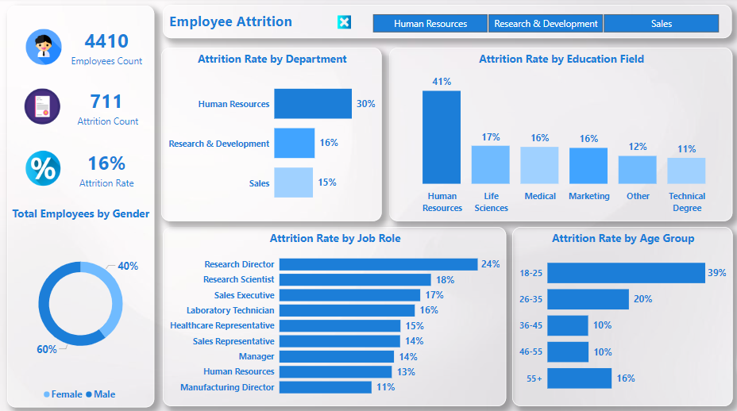

Slide 6
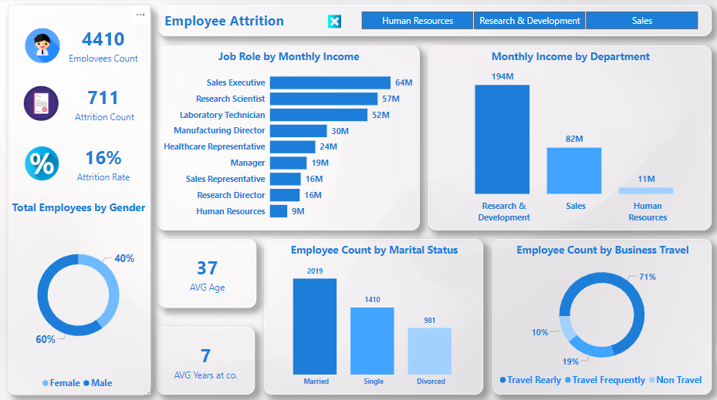

Slide 7
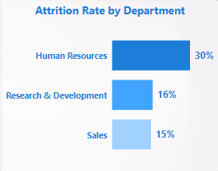

Slide 8
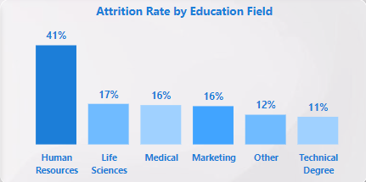

Slide 9
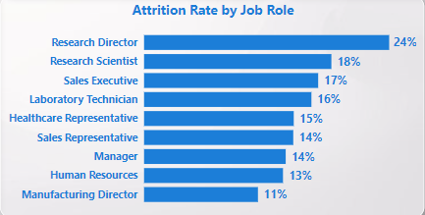

Slide 10
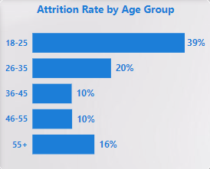

Slide 11
Conclusion
The analysis of XYZ Company's employee data has provided valuable insights into the factors contributing to the organization's 15% attrition rate. Key findings indicate that factors such as job role, department, business travel frequency, distance from home, and years since last promotion significantly influence employee turnover. Additionally, aspects like job involvement, work-life balance, and satisfaction levels play a crucial role in employee retention.
By addressing these factors through targeted interventions, XYZ Company can reduce its attrition rate and foster a more engaged and satisfied workforce. Implementing strategies such as improving work-life balance, offering career growth opportunities, and enhancing employee satisfaction across various departments will be vital in retaining top talent.
The interactive dashboard created as part of this project will enable XYZ Company to continuously monitor these key indicators and make data-driven decisions aimed at reducing attrition.

